Slide 1
How do humans develop two systems for mindreading?
Apperly & Butterfill
Notes:
How do humans develop two systems for mindreading?
Our question presupposes that human adults (at least) do have two systems for mindreading.
Actually this is something we want to argue for rather than assume.
So let me start by making a distinction and an observation ...

Slide 2
Is adult mindreading automatic
Notes:
The distinction is between processes which are automatic
and those which are not.
Roughly speaking,
a process is *automatic* if it occurs irrespective of its relevance to the particulars of an agent's motives and aims.

Slide 3
Is adult mindreading automatic?
Notes:
The puzzle starts with a question.
Is adult mindreading automatic or not?

Slide 4
Is adult mindreading automatic?
Kovacs et al (2010): yes!
Notes:
Some evidence suggests that it is.
For example,
Kovacs and colleagues (2010) asked adults to identify the location of a ball.
They found that adults were significantly slower to identify the ball's location when an onlooker had a false belief about the location of the ball,
even though the onlooker's belief was not relevant to the task at all.
This and related findings seem to suggest that, at least in adults, mindreading is automatic.

Slide 5
Is adult mindreading automatic?
Kovacs et al (2010): yes!
Back & Apperly (2010): no!
Notes:
By contrast,
Back & Apperly (2010) found that subjects are significantly slower to answer an unexpected question about another's belief when that belief is false compared to when it is true.
This suggests that, at least in adults, mindreading is not automatic.
So my question is whether adult mindreading is automatic.
And this question is puzzling because there seems to be evidence for both positive and negative answers.

Slide 6
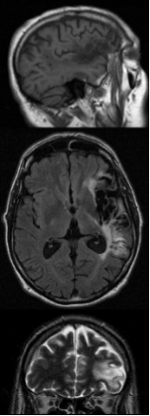

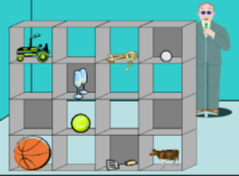
Evidence that mindreading is a flexible but demanding ability
  In Adults....
  Impaired executive processes can lead to severe egocentrism
    (e.g., Samson, Apperly, Kathirgamanathan & Humphreys, 2005)
  Belief inferences are not made automatically
    (Apperly, Samson, Riggs, Simpson & Chiavarino, 2006; Back & Apperly, 2010)
  Belief inferences are not used automatically
    (e.g., Keysar, Lin & Barr, 2003; Apperly et al., 2010)
  Holding false beliefs briefly in mind has a measurable processing cost
    (Apperly, Back et al., 2008)
  Belief reasoning requires cognitive control
    (e.g., Bull, Philips & Conway, 2007)
  ...and this fits with evidence from children.
Notes:
There's a bigger picture here concerning the cognitive characteristics of mindreading ...

Slide 7
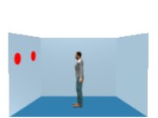
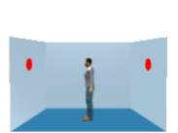
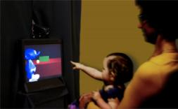
Evidence that mindreading is an efficient but inflexible ability
  In Adults....
  Mindreading may occur without instruction....
    “Level-1” visual perspectives (Samson, Apperly, Braithwaite, Andrews and Bodley Scott, 2010)
    false beliefs about location (Kovacs, Teglas & Endress, 2010)
  ...and without awareness
    False beliefs about location (Kovacs et al., 2010 ; Schneider, Bayliss, Becker & Dux, 2011)
  Mindreading others’ mental states may cause interference with one’s own judgements
    Kovacs et al. (2010), Samson et al. (2010)
  Mindreading others’ mental states is not disrupted by a secondary executive task. Interference from their mental states is increased.
    Qureshi, Apperly & Samson (2010)
  Such “automatic”, “efficient” processing may not extend to more complex cases
    No evidence in “Level-2” perspective-taking (Surtees, Butterfill & Apperly, in press)
  ....and this fits with evidence from infants

Slide 8
  So there really are substantial bodies of conflicting evidence
  Such findings lead us to suggest that adults have “two systems” for mindreading
    Apperly & Butterfill, 2009; Apperly, 2010; Butterfill & Apperly, under review.

Slide 9





What is the relationship between the abilities of infants and adults?
Effortful & Flexible
Efficient & limited
Efficient & limited

Slide 10
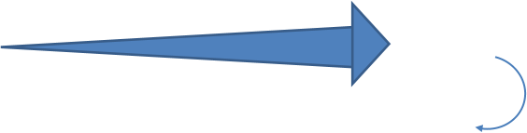


What is the relationship between the abilities of infants and adults?
a.
Infant system grows up
(+ Language, Executive function, Knowledge)
Effortful & Flexible
Efficient & limited
Automatisation
Efficient & limited

Slide 11

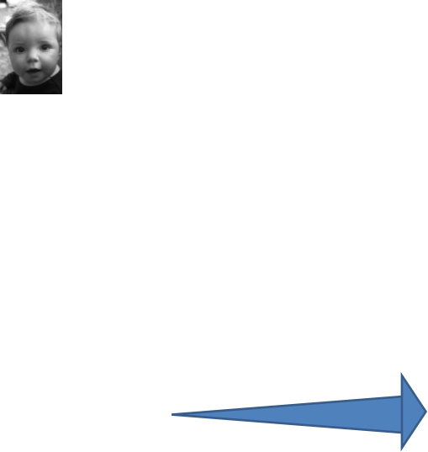
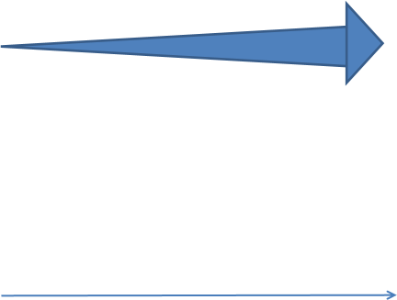








What is the relationship between the abilities of infants and adults?
a.
Infant system grows up
(+ Language, Executive function, Knowledge)
Effortful & Flexible
Automatisation
Efficient & limited
b.
Infant system remains intact
Efficient & limited
Efficient & limited
(+ Language, Executive function, Knowledge)
Automatisation
Effortful & Flexible

Slide 12
What is the relationship between the abilities of infants and adults?
a.
Infant system grows up
(+ Language, Executive function, Knowledge)
Effortful & Flexible
Efficient & limited
Automatisation
Efficient & limited
b.
Infant system remains intact
Efficient & limited
Efficient & limited
(+ Language, Executive function, Knowledge)
Automatisation
Effortful & Flexible
Notes:
hyp1 = automaticity through automatization
hyp2 = original automaticity

Slide 13





What is the relationship between the abilities of infants and adults?
a.
Infant system grows up
(+ Language, Executive function, Knowledge)
Effortful & Flexible
Efficient & limited
Automatisation
Efficient & limited
b.
Infant system remains intact
Efficient & limited
Efficient & limited
(+ Language, Executive function, Knowledge)
Automatisation
Effortful & Flexible
Notes:
possibly move down / copy to end?

Slide 14
Propositional attitude
Notes:
So the question is how we develop two systems for mindreading, one automatic the other not. Two hypotheses are:
a. automaticity through automatization
and
b. original automaticity.
(Define 'originally automatic' mindreading as mindreading that is automatic and not a consequence of automatization.)
Our suggestion is that
(i) automatic mindreading systems are subject to arbitrary limits (because automaticity involves trading flexibility for efficiency),
and
(ii) we can distinguish the two hypotheses by finding arbitrary limits on automatic mindreading in infants and adults.
If the limits match, this is evidence for original automaticity.
If the limits differ, this is evidence for automaticity through automatization.
What sorts of limits might we expect to find on originally automatic mindreading?
Full-blown, explicit mindreading involves representing beliefs, desires and other propositional attitudes.
Propositional attitudes---including beliefs---are states which form complex causal structures, have arbitrarily nest-able contents, and are individuated by their causal and normative roles in explaining thoughts and actions.
If anything should make a cognitive process effortful, it is surely representing states with that combination of properties
So there are strong theoretical reasons to suppose that originally automatic mindreading could not involve representing propositional attitudes as such.

Slide 15
Propositional attitude
Relational attitude
Notes:
Elsewhere Ian and I have suggested, in effect, that originally automatic mindreading involves representing relational attitudes ...

Slide 16
Propositional attitude
Relational attitude
e.g. believes that ...
e.g. intends that ...
e.g. knows that ...
e.g. excited by ...
e.g. encountered ...
e.g. wants apple juice
Notes:
Paradigmatic examples of relational attitudes are things like
being excited by an event,
encountering an object,
or wanting some type of thing.

Slide 17
Propositional attitude
Relational attitude
e.g. believes that ...
e.g. intends that ...
e.g. knows that ...
e.g. excited by ...
e.g. encountered ...
e.g. wants apple juice
arbitrarily nestable contents
uncodifiably complex effects on action
permit mistakes about appearance, identity and existence
no contents
parameter-setting effects on action
enable tracking a
limited range of false beliefs only
Notes:
whereas propositional attitudes have arbitrarily nestable contents,
relational attitudes have no contents
whereas propositional attitudes have uncodifiably complex effects on action,
relational attitudes set parameters for action
and whereas representing relational attitudes would permit a mindreader to track false beliefs involving mistakes about
appearances,
identity
and
existence,
representing relational attitudes would allow one to track only a limited range of false beliefs about properties such as location, colour and shape.
So consider this hypothesis:
whereas non-automatic mindreading involves representing propositional attitudes,
automatic mindreading involves representing relational attitudes only.
This hypothesis, if true, would explain why automatic mindreading is less demanding than full-blown mindreading.

Slide 18
Propositional attitude
Relational attitude
e.g. believes that ...
e.g. intends that ...
e.g. knows that ...
e.g. excited by ...
e.g. encountered ...
e.g. wants apple juice
arbitrarily nestable contents
uncodifiably complex effects on action
permit mistakes about appearance, identity and existence
no contents
parameter-setting effects on action
enable tracking
a limited range of false beliefs only
Notes:
This hypothesis also has the virtue of indicating what sort of limits could distinguish automatic from full-blown mindreading ...

Slide 19
Propositional attitude
Relational attitude
level-1 perspective taking
level-2 perspective taking
Y
Y
Y
N
Notes:
for the hypothesis suggests that
- automatic mindreading should be good for level-1 perspective taking tasks,
but not for level-2 perspective taking tasks.
Some work on the level-1/level-2 distinction has already been published,
and this does suggest that for both children and adults,
automatic mindreading may be sufficient for success on level-1 but not level-2 perspective taking tasks.
But since this has already been published I don't want to cover that here.

Slide 20
Propositional attitude
Relational attitude
level-1 perspective taking
level-2 perspective taking
false beliefs about non-existence
Y
Y
Y
Y
N
N
Notes:
The hypothesis about relational attitudes also suggests that
- automatic mindreading should be good for tracking false beliefs with a simple predicate-object structure, but not for tracking false beliefs which essentially involve the non-existence of something.

Slide 21
Propositional attitude
Relational attitude
level-1 perspective taking
level-2 perspective taking
false beliefs about non-existence
false beliefs about location
false beliefs about identity
Y
Y
Y
Y
Y
Y
N
N
Y
N
Notes:
and, finally, the hypothesis suggests that
-automatic mindreading should be good for tracking false beliefs about the location of something,
but not for tracking false beliefs which essentially involve mistakes about identity.
So one nice feature of this hypothesis is that it makes several independently testable predictions about the limits of automatic mindreading.
If we want to find out whether adult automatic mindreading and infant mindreading are subject to the same limits,
it makes sense to start by looking at these limits.
I want to finish by focusing on the issue of false beliefs about location vs. false beliefs about identity.
What do we mean by a mistake about identity?
Here's an illustration.
Suppose that a single person has two roles that don't often go together,
say she is both a school teacher by day and an assassin by night.
If you shot the assassin, you might be surprised that the school teacher doesn't turn up to work.
They are one and the same person but you didn't know that.
This would be a mistake about identity: in mistakenly expecting the school teacher to turn up, you have failed to realise that she is the assassin.
Your mistake could be predicted by subjects who can represent propositional attitudes as such.
But it cannot be predicted by subjects who represent relational attitudes only.

Slide 22
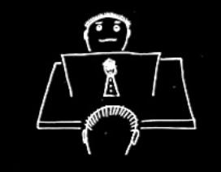
Notes:
Here's how this idea might work in a format suitable for infants and adults (without the shooting).
On the screen you can see the back of the subject's head.
He is sitting opposite the protagonist.
On the table there is a screen.
Behind the screen there is a puppet.
The puppet will serve as the school teacher-assassin.
The protagonist can't see behind the barrier.
She can't see the puppet right now.
But the subject can see everything.

Slide 23
Notes:
This is the same thing, just smaller so that I can show you how the story unfolds.
I should say that the puppet has a face and costume with two aspects.
Seen from one side she looks like an assassin.
Seen from the other she looks like a school teacher.

Slide 24
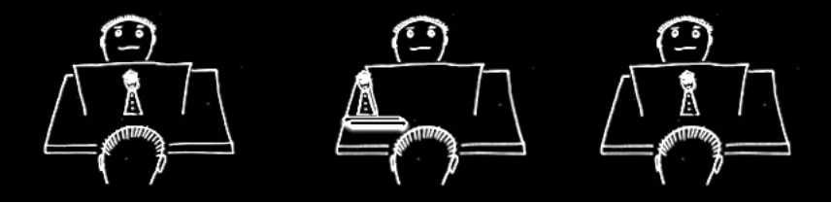
Notes:
The puppet comes out from behind the barrier appearing to the protagonist as a school teacher.
Then she returns behind the barrier.

Slide 25
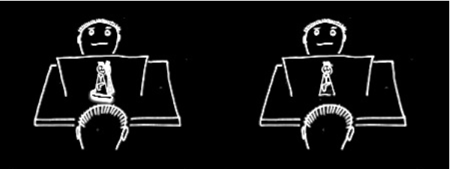
Notes:
The puppet now rotates behind the barrier.
The subject can see this but the protagonist can't.

Slide 26
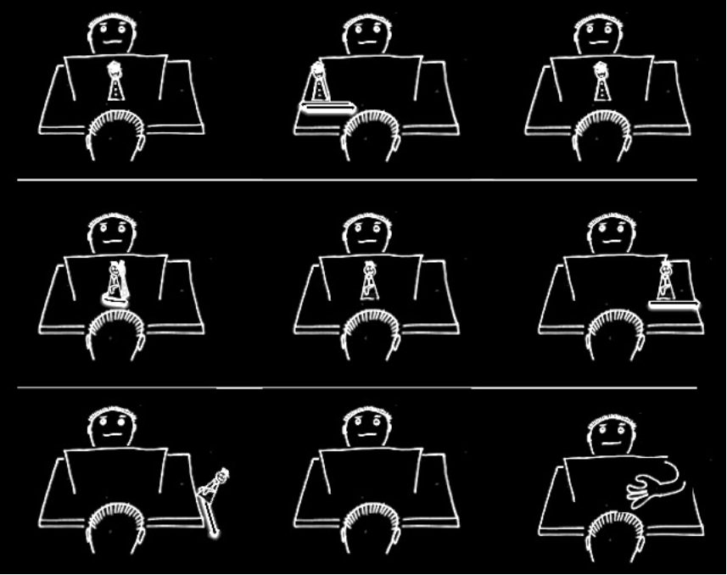

Notes:
Now the puppet goes out from behind the barrier.
This time she looks to the protagonist as if she is an assassin.
The protagonist shoots her and she falls off the table.
So to the protagonist it looks like the assassin has been shot.
But the subject knows that the assassin is the school teacher.

Slide 27
Notes:
In the final phase,
the protagonist reaches around the barrier.
If the subject can represent propositional attitudes as such this makes perfect sense:
the protagonist wants to retrieve the school teacher.
But if the subject is representing relational attitudes only,
this reaching doesn't make any sense.
For the assassin is the school teacher,
and so one's disappearance is the other's disappearance.
So the protagonist's reach should be expected to subjects who represent propositional attitudes but unexpected to subjects who represent relational attitudes only.
[Don't mention control conditions]

Slide 28
Propositional attitude
Relational attitude
level-1 perspective taking
level-2 perspective taking
false beliefs about non-existence
false beliefs about location
false beliefs about identity
Y
Y
Y
Y
Y
Y
N
N
Y
N
Notes:
So this was our idea.
We want to know whether adults' automatic mindreading is (a) automatic through automatization
or
(b) originally automatic.
Our suggestion is that if adult automatic mindreading is originally automatic, then it should be subject to the same arbitrary limits as infant mindreading.
And there are theoretical reasons to suppose that originally automatic mindreading would involve representing relational attitudes only, not propositional attitudes.
Someone who represents relational attitudes only
should have no problem tracking false beliefs about location
but should fail to track false beliefs about identity.
And, as I've just tried to illustrate, it would be possible to test for abilities to track false beliefs about identity using designs very similar to those used to track false beliefs about location.
So here is a way to test for original automaticity.
If we find that infant mindreading is like adult automatic mindreading in that neither enables them to track false beliefs about identity,
then we have evidence for original automaticity.
But if it turns out that infants and adults differ in this respect,
then we have evidence for automaticity by automatization.

Slide 29
What is the relationship between the abilities of infants and adults?
a.
Infant system grows up
(+ Language, Executive function, Knowledge)
Effortful & Flexible
Efficient & limited
Automatisation
Efficient & limited
b.
Infant system remains intact
Efficient & limited
Efficient & limited
(+ Language, Executive function, Knowledge)
Automatisation
Effortful & Flexible

